Slide 1
CSE 486/586 Distributed Systems Domain Name System
Steve Ko
Computer Sciences and Engineering
University at Buffalo

Slide 2
Last Time
Two multicast algorithms for total ordering
Sequencer
ISIS
Multicast for causal ordering
Uses vector timestamps

Slide 3
Review: Causally Ordered Multicast
Each process keeps a vector clock.
Each counter represents the number of messages received from each of the other processes.
When multicasting a message, the sender process increments its own counter and attaches its vector clock.
Upon receiving a multicast message, the receiver process waits until it can preserve causal ordering:
It has delivered all the messages from the sender.
It has delivered all the messages that the sender had delivered before the multicast message.

Slide 4
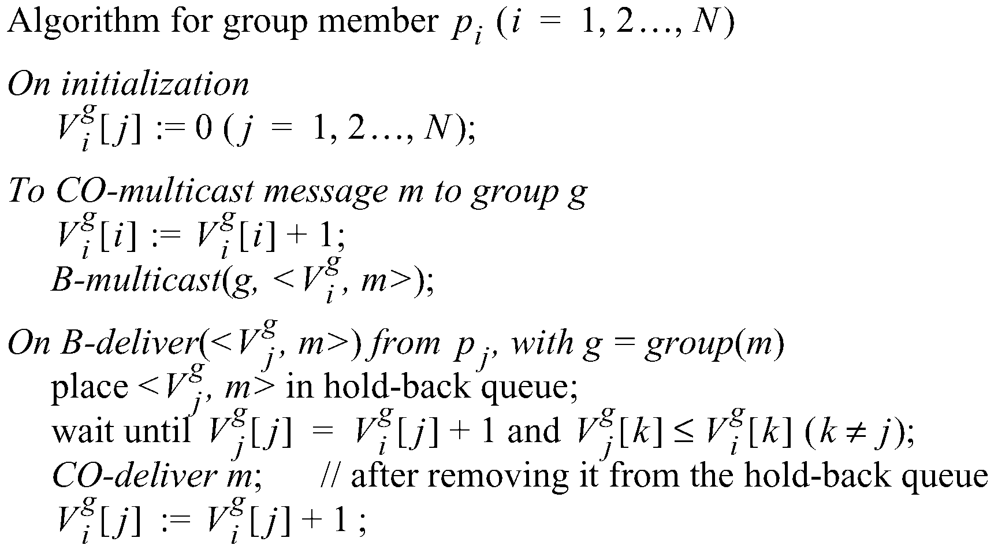
Review: Causal Ordering
The number of group-g messages
from process j that have been seen at
process i so far

Slide 5
Example: Causal Ordering Multicast
Reject:
Accept
P1
1,0,0
1,1,0
1,1,0
0,0,0
(1,0,0)
(1,1,0)
(1,1,0)
P2
0,0,0
1,0,0
1,1,0
(1,1,0)
(1,0,0)
P3
0,0,0
1,0,0
1,1,0
1,1,0
Accept
Accept:
Accept Buffered message
Buffer, missing P1(1)
Physical Time

Slide 6
Today’s Question
How do we organize the nodes in a distributed system?
Up to the 90’s
Prevalent architecture: client-server (or master-slave)
Unequal responsibilities
Now
Emerged architecture: peer-to-peer
Equal responsibilities
Studying an example client-server: DNS (today)
Studying peer-to-peer as a paradigm (not just as a file-sharing application)
Learn the techniques and principles

Slide 7

Separating Names and IP Addresses
Names are easier (for us!) to remember
www.cnn.com vs. 64.236.16.20
IP addresses can change underneath
Move www.cnn.com to 173.15.201.39
E.g., renumbering when changing providers
Name could map to multiple IP addresses
www.cnn.com to multiple replicas of the Web site
Map to different addresses in different places
Address of a nearby copy of the Web site
E.g., to reduce latency, or return different content
Multiple names for the same address
E.g., aliases like ee.mit.edu and cs.mit.edu

Slide 8
Two Kinds of Identifiers
Host name (e.g., www.cnn.com)
Mnemonic name appreciated by humans
Provides little (if any) information about location
Hierarchical, variable # of alpha-numeric characters
IP address (e.g., 64.236.16.20)
Numerical address appreciated by routers
Related to host’s current location in the topology
Hierarchical name space of 32 bits

Slide 9
Hierarchical Assignment Processes
Host name: www.cse.buffalo.edu
Domain: registrar for each top-level domain (e.g., .edu)
Host name: local administrator assigns to each host
IP addresses: 128.205.32.58
Prefixes: ICANN, regional Internet registries, and ISPs
Hosts: static configuration, or dynamic using DHCP

Slide 10
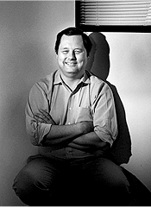
Domain Name System (DNS)
Proposed in 1983 by Paul Mockapetris

Slide 11
Overview: Domain Name System
A client-server architecture
The server-side is still distributed for scalability.
But the servers are still a hierarchy of clients and servers
Computer science concepts underlying DNS
Indirection: names in place of addresses
Hierarchy: in names, addresses, and servers
Caching: of mappings from names to/from addresses
DNS software components
DNS resolvers
DNS servers
DNS queries
Iterative queries
Recursive queries
DNS caching based on time-to-live (TTL)

Slide 12
Strawman Solution #1: Local File
Original name to address mapping
Flat namespace
/etc/hosts
SRI kept main copy
Downloaded regularly
Count of hosts was increasing: moving from a machine per domain to machine per user
Many more downloads
Many more updates

Slide 13
Strawman Solution #2: Central Server
Central server
One place where all mappings are stored
All queries go to the central server
Many practical problems
Single point of failure
High traffic volume
Distant centralized database
Single point of update
Does not scale
Need a distributed, hierarchical collection of servers

Slide 14
Domain Name System (DNS)
Properties of DNS
Hierarchical name space divided into zones
Distributed over a collection of DNS servers
Hierarchy of DNS servers
Root servers
Top-level domain (TLD) servers
Authoritative DNS servers
Performing the translations
Local DNS servers
Resolver software

Slide 15
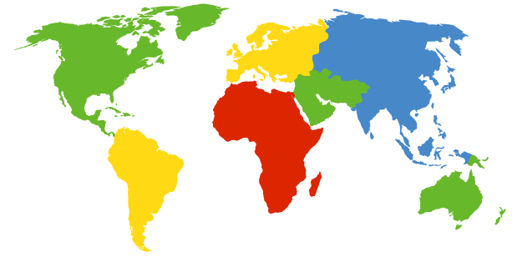
DNS Root Servers
13 root servers (see http://www.root-servers.org/)
Labeled A through M
A Verisign, Dulles, VA
C Cogent, Herndon, VA (also Los Angeles)
D U Maryland College Park, MD
G US DoD Vienna, VA
H ARL Aberdeen, MD
J Verisign, ( 11 locations)
K RIPE London (+ Amsterdam, Frankfurt)
I Autonomica, Stockholm (plus 3 other locations)
E NASA Mt View, CA
F Internet Software C. Palo Alto, CA (and 17 other locations)
m WIDE Tokyo
B USC-ISI Marina del Rey, CA
L ICANN Los Angeles, CA

Slide 16
TLD and Authoritative DNS Servers
Top-level domain (TLD) servers
Generic domains (e.g., com, org, edu)
Country domains (e.g., uk, fr, ca, jp)
Typically managed professionally
Network Solutions maintains servers for “com”
Educause maintains servers for “edu”
Authoritative DNS servers
Provide public records for hosts at an organization
For the organization’s servers (e.g., Web and mail)
Can be maintained locally or by a service provider

Slide 17
Distributed Hierarchical Database
unnamed root
com
edu
org
ac
uk
zw
arpa
generic domains
country domains
bar
ac
in-
addr
west
east
cam
12
foo
my
usr
34
my.east.bar.edu
usr.cam.ac.uk
56
12.34.56.0/24

Slide 18
Using DNS
Local DNS server (“default name server”)
Usually near the end hosts who use it
Local hosts configured with local server (e.g., /etc/resolv.conf) or learn the server via DHCP
Client application
Extract server name (e.g., from the URL)
Do gethostbyname() to trigger resolver code
Server application
Extract client IP address from socket
Optional gethostbyaddr() to translate into name

Slide 19
CSE 486/586 Administrivia
Please start PA2 if you haven’t.
PA1 grades will be out over the coming weekend.
AWS codes are distributed on UBLearns.
Will post setup instructions.
Practice problem set 1 & midterm example posted on the course website.
Moving the midterm from Friday (3/8) to Wednesday (3/6)?
Come talk to me!

Slide 20
Example
root DNS server
Host at cis.poly.edu wants IP address for gaia.cs.umass.edu
2
3
TLD DNS server
4
local DNS server
dns.poly.edu
5
7
6
1
8
authoritative DNS server
dns.cs.umass.edu
requesting host
cis.poly.edu
gaia.cs.umass.edu

Slide 21
Recursive vs. Iterative Queries
Recursive query
Ask server to get answer for you
E.g., request 1 and response 8
Iterative query
Ask server who to ask next
E.g., all other request-response pairs
root DNS server
2
3
TLD DNS server
4
local DNS server
dns.poly.edu
5
7
6
1
8
authoritative DNS server
dns.cs.umass.edu
requesting host
cis.poly.edu

Slide 22
DNS Caching
Performing all these queries take time
And all this before the actual communication takes place
E.g., 1-second latency before starting Web download
Caching can substantially reduce overhead
The top-level servers very rarely change
Popular sites (e.g., www.cnn.com) visited often
Local DNS server often has the information cached
How DNS caching works
DNS servers cache responses to queries
Responses include a “time to live” (TTL) field
Server deletes the cached entry after TTL expires

Slide 23
Negative Caching
Remember things that don’t work
Misspellings like www.cnn.comm and www.cnnn.com
These can take a long time to fail the first time
Good to remember that they don’t work
… so the failure takes less time the next time around

Slide 24
DNS Resource Records
DNS: distributed db storing resource records (RR)
RR format: (name, value, type, ttl)
Type=A
name is hostname
value is IP address
Type=CNAME
name is alias for some “canonical” (the real) name:
www.ibm.com is really
srveast.backup2.ibm.com
value is canonical name
Type=NS
name is domain
(e.g. foo.com)
value is hostname of authoritative name server for this domain
Type=MX
value is name of mailserver associated with name

Slide 25
Reliability
DNS servers are replicated
Name service available if at least one replica is up
Queries can be load balanced between replicas
UDP used for queries
Need reliability: must implement this on top of UDP
Try alternate servers on timeout
Exponential backoff when retrying same server
Same identifier for all queries
Don’t care which server responds

Slide 26

Inserting Resource Records into DNS
Example: just created startup “FooBar”
Register foobar.com at Network Solutions
Provide registrar with names and IP addresses of your authoritative name server (primary and secondary)
Registrar inserts two RRs into the com TLD server:
(foobar.com, dns1.foobar.com, NS)
(dns1.foobar.com, 212.212.212.1, A)
Put in authoritative server dns1.foobar.com
Type A record for www.foobar.com
Type MX record for foobar.com
Play with “dig” on UNIX

Slide 27
$ dig nytimes.com ANY
; QUESTION SECTION:
;nytimes.com. IN ANY
;; ANSWER SECTION:
nytimes.com. 267 IN MX 100 NYTIMES.COM.S7A1.PSMTP.com.
nytimes.com. 267 IN MX 200 NYTIMES.COM.S7A2.PSMTP.com.
nytimes.com. 267 IN A 199.239.137.200
nytimes.com. 267 IN A 199.239.136.200
nytimes.com. 267 IN TXT "v=spf1 mx ptr ip4:199.239.138.0/24 include:alerts.wallst.com include:authsmtp.com ~all"
nytimes.com. 267 IN SOA ns1t.nytimes.com. root.ns1t.nytimes.com. 2009070102 1800 3600 604800 3600
nytimes.com. 267 IN NS nydns2.about.com.
nytimes.com. 267 IN NS ns1t.nytimes.com.
nytimes.com. 267 IN NS nydns1.about.com.
;; AUTHORITY SECTION:
nytimes.com. 267 IN NS nydns1.about.com.
nytimes.com. 267 IN NS ns1t.nytimes.com.
nytimes.com. 267 IN NS nydns2.about.com.
;; ADDITIONAL SECTION:
nydns1.about.com. 86207 IN A 207.241.145.24
nydns2.about.com. 86207 IN A 207.241.145.25

Slide 28
$ dig nytimes.com +norec @a.root-servers.net
;; ->>HEADER<<- opcode: QUERY, status: NOERROR, id: 53675
;; flags: qr; QUERY: 1, ANSWER: 0, AUTHORITY: 13, ADDITIONAL: 14
;; QUESTION SECTION:
;nytimes.com. IN A
;; AUTHORITY SECTION:
com. 172800 IN NS K.GTLD-SERVERS.NET.
com. 172800 IN NS E.GTLD-SERVERS.NET.
com. 172800 IN NS D.GTLD-SERVERS.NET.
com. 172800 IN NS I.GTLD-SERVERS.NET.
com. 172800 IN NS C.GTLD-SERVERS.NET.
;; ADDITIONAL SECTION:
A.GTLD-SERVERS.NET. 172800 IN A 192.5.6.30
A.GTLD-SERVERS.NET. 172800 IN AAAA 2001:503:a83e::2:30
B.GTLD-SERVERS.NET. 172800 IN A 192.33.14.30
B.GTLD-SERVERS.NET. 172800 IN AAAA 2001:503:231d::2:30
C.GTLD-SERVERS.NET. 172800 IN A 192.26.92.30
D.GTLD-SERVERS.NET. 172800 IN A 192.31.80.30
E.GTLD-SERVERS.NET. 172800 IN A 192.12.94.30
;; Query time: 76 msec
;; SERVER: 198.41.0.4#53(198.41.0.4)
;; WHEN: Mon Feb 23 11:24:06 2009
;; MSG SIZE rcvd: 501

Slide 29
$ dig nytimes.com +norec @k.gtld-servers.net
;; ->>HEADER<<- opcode: QUERY, status: NOERROR, id: 38385
;; flags: qr; QUERY: 1, ANSWER: 0, AUTHORITY: 3, ADDITIONAL: 3
;; QUESTION SECTION:
;nytimes.com. IN A
;; AUTHORITY SECTION:
nytimes.com. 172800 IN NS ns1t.nytimes.com.
nytimes.com. 172800 IN NS nydns1.about.com.
nytimes.com. 172800 IN NS nydns2.about.com.
;; ADDITIONAL SECTION:
ns1t.nytimes.com. 172800 IN A 199.239.137.15
nydns1.about.com. 172800 IN A 207.241.145.24
nydns2.about.com. 172800 IN A 207.241.145.25
;; Query time: 103 msec
;; SERVER: 192.52.178.30#53(192.52.178.30)
;; WHEN: Mon Feb 23 11:24:59 2009
;; MSG SIZE rcvd: 144

Slide 30
$ dig nytimes.com ANY +norec @ns1t.nytimes.com
;; ->>HEADER<<- opcode: QUERY, status: NOERROR, id: 39107
;; flags: qr aa; QUERY: 1, ANSWER: 13, AUTHORITY: 0, ADDITIONAL: 1
;; QUESTION SECTION:
;nytimes.com. IN ANY
;; ANSWER SECTION:
nytimes.com. 300 IN SOA ns1t.nytimes.com.
root.ns1t.nytimes.com. 2009070102 1800 3600 604800 3600
nytimes.com. 300 IN MX 200 NYTIMES.COM.S7A2.PSMTP.com.
nytimes.com. 300 IN MX 100 NYTIMES.COM.S7A1.PSMTP.com.
nytimes.com. 300 IN NS ns1t.nytimes.com.
nytimes.com. 300 IN NS nydns1.about.com.
nytimes.com. 300 IN NS nydns2.about.com.
nytimes.com. 300 IN A 199.239.137.245
nytimes.com. 300 IN A 199.239.136.200
nytimes.com. 300 IN A 199.239.136.245
nytimes.com. 300 IN TXT "v=spf1 mx ptr ip4:199.239.138.0/24
include:alerts.wallst.com include:authsmtp.com ~all"
;; ADDITIONAL SECTION:
ns1t.nytimes.com. 300 IN A 199.239.137.15
;; Query time: 10 msec
;; SERVER: 199.239.137.15#53(199.239.137.15)
;; WHEN: Mon Feb 23 11:25:20 2009
;; MSG SIZE rcvd: 454

Slide 31
Content Distribution Networks (CDNs)
31
Content providers are CDN customers
Content replication
CDN company installs thousands of servers throughout Internet
In large datacenters
Or, close to users
CDN replicates customers’ content
When provider updates content, CDN updates servers
origin server
in North America
CDN distribution node
CDN server
in S. America
CDN server
in Asia
CDN server
in Europe

Slide 32
Content Distribution Networks
Replicate content on many servers
Challenges
How to replicate content
Where to replicate content
How to find replicated content
How to choose among replicas
How to direct clients towards a replica

Slide 33
Server Selection
Which server?
Lowest load: to balance load on servers
Best performance: to improve client performance
Based on what? Location? RTT? Throughput? Load?
Any alive node: to provide fault tolerance
How to direct clients to a particular server?
As part of routing: anycast, cluster load balancer
As part of application: HTTP redirect
As part of naming: DNS

Slide 34
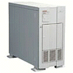

How Akamai Works
34
cnn.com (content provider)
HTTP
DNS root server
GET index.html
Akamai
cluster
http://cache.cnn.com/cnn.com/foo.jpg
Akamai global
DNS server
1
2
HTTP
Akamai regional
DNS server
Nearby Akamai
cluster
End-user

Slide 35
How Akamai Works
35
cnn.com (content provider)
HTTP
DNS root server
DNS lookup
cache.cnn.com
Akamai
cluster
Akamai global
DNS server
1
2
3
ALIAS:
g.akamai.net
4
Akamai regional
DNS server
Nearby Akamai
cluster
End-user

Slide 36
How Akamai Works
36
cnn.com (content provider)
HTTP
DNS root server
DNS lookup
g.akamai.net
Akamai
cluster
Akamai global
DNS server
5
1
2
3
4
6
Akamai regional
DNS server
ALIAS
a73.g.akamai.net
Nearby Akamai
cluster
End-user

Slide 37
How Akamai Works
37
cnn.com (content provider)
HTTP
DNS root server
Akamai
cluster
Akamai global
DNS server
5
1
2
3
4
6
Akamai regional
DNS server
7
DNS a73.g.akamai.net
8
Address
1.2.3.4
Nearby Akamai
cluster
End-user

Slide 38
How Akamai Works
38
cnn.com (content provider)
HTTP
DNS root server
Akamai
cluster
Akamai global
DNS server
5
1
2
3
4
6
Akamai regional
DNS server
7
8
9
Nearby Akamai
cluster
End-user
GET /foo.jpg
Host: cache.cnn.com

Slide 39

How Akamai Works
39
cnn.com (content provider)
HTTP
DNS root server
GET foo.jpg
11
12
Akamai
cluster
Akamai global
DNS server
5
1
2
3
4
6
Akamai regional
DNS server
7
8
9
Nearby Akamai
cluster
End-user
GET /foo.jpg
Host: cache.cnn.com

Slide 40
How Akamai Works
40
cnn.com (content provider)
HTTP
DNS root server
11
12
Akamai
cluster
Akamai global
DNS server
5
1
2
3
4
6
Akamai regional
DNS server
7
8
9
Nearby Akamai
cluster
End-user
10

Slide 41
Summary
DNS as an example client-server architecture
Why?
Names are easier (for us!) to remember
IP addresses can change underneath
Name could map to multiple IP addresses
Map to different addresses in different places
Multiple names for the same address
Properties of DNS
Distributed over a collection of DNS servers
Hierarchy of DNS servers
Root servers, top-level domain (TLD) servers, authoritative DNS servers

Slide 42
Acknowledgements
These slides contain material developed and copyrighted by Indranil Gupta (UIUC), Michael Freedman (Princeton), and Jennifer Rexford (Princeton).

